Slide 1
19AD784
IMAGE ANALYSIS AND COMPUTER VISION
Dr E Emerson Nithiyaraj
AP/ECE

Slide 2
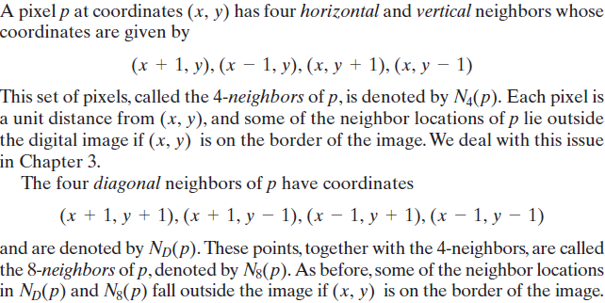
Neighbors of a Pixel

Slide 3
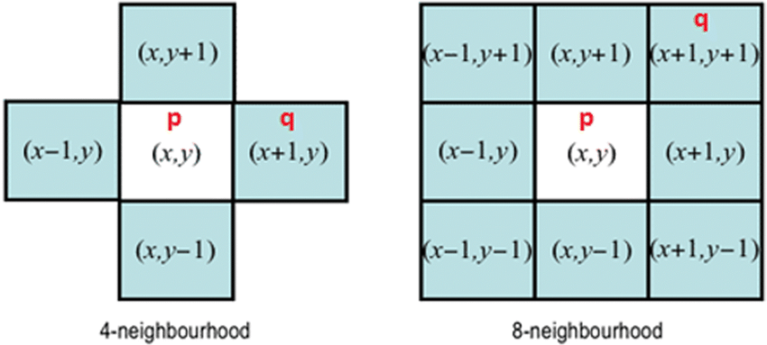
Neighbors of a Pixel

Slide 4
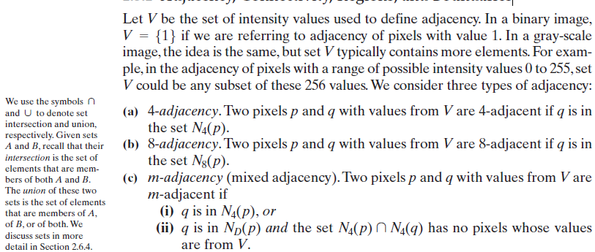
Adjacency, Connectivity, Regions, and Boundaries

Slide 5
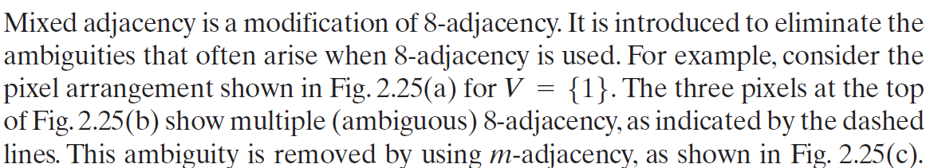

Slide 6
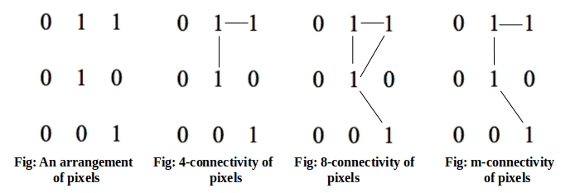

Slide 7
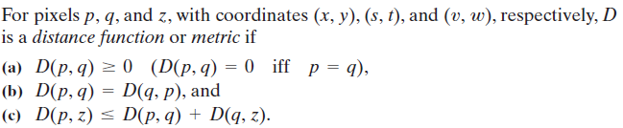
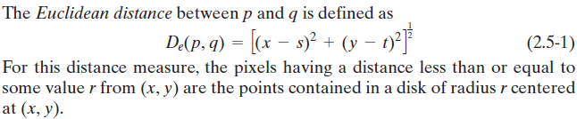
Distance Measures

Slide 8
Distance Measures

Slide 9
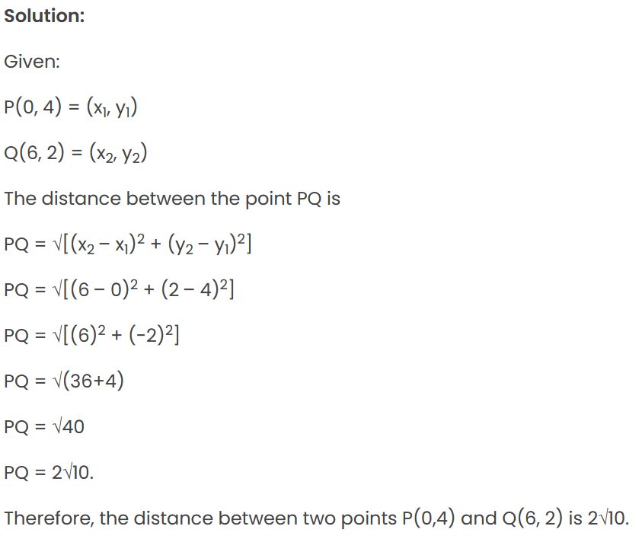
Distance Measures

Slide 10
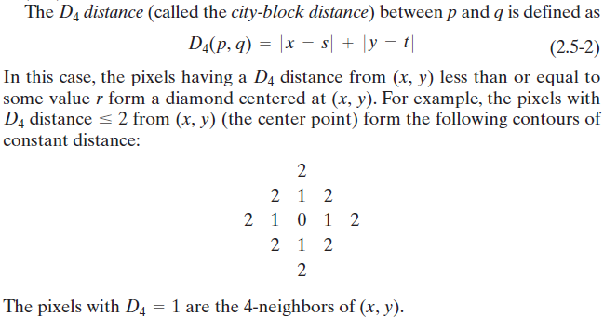
Distance Measures

Slide 11
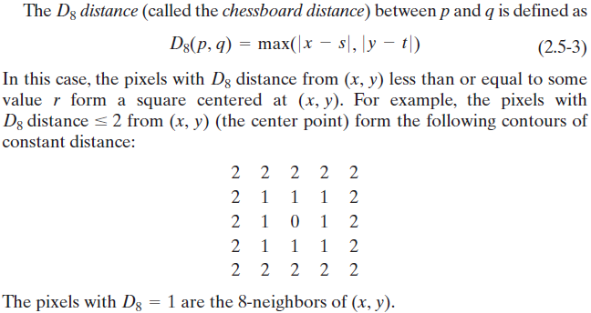
Distance Measures

